Slide 1
CSCI 5461 Final Project
By Nathan, William, Ryan and Montha

Slide 2
Introduction
Goal: Predict Human gene function
TensorFlow Neural Network, Random Forest classifier (3 Variants), KNN

Slide 3
Methods
Neural Net & KNN

Slide 4
Neural Net
7 layers
1 Input Layer - 1100 Nodes - Relu activation function
2 Hidden Layers - 1100 Nodes - Relu activation function
3 Dropout Layers
1 Output Layer - 1106 Nodes - Sigmoid activation function
Biased Output Layer
The output layer contained a bias node for each output node. The bias was manually computed for each GO term by counting the positive and negative labels and then taking the log(positive/negative)
Improved the convergence of the model
6 Training Epochs
More epochs resulted in overfitting

Slide 5
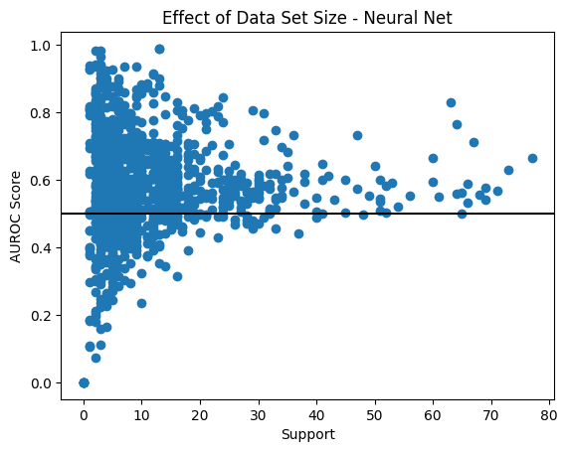
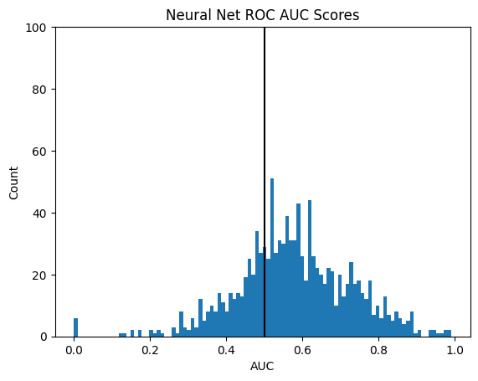
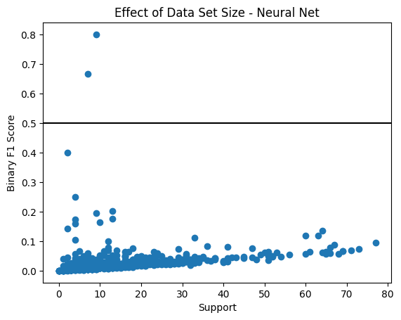
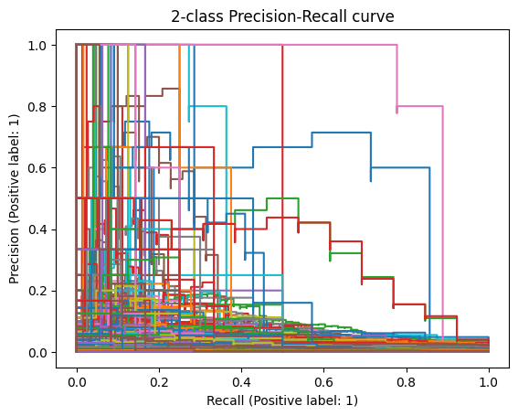
Neural Net Results
Mean AUROC - 58.8%
Mean Weighted F1 - 74.4%

Slide 6
Neural Net Analysis
The best predicted GO Terms ranked by binary F1 Scores
GO:0070125 - mitochondrial fusion
GO:0070126 - mitochondrial fission
GO:0006120 - mitochondrial electron transport
GO:0007029 - endoplasmic reticulum organization
GO:0032981 - mitochondrial respiratory chain complex I assembly
The binary F1 vs support plot has some interesting insights as there appears to be a linear relationship with increasing support and increasing F1 score

Slide 7
KNN Classifier
Parameters
K - 2
Distance metric - Euclidean Distance
Weights - Uniform
Undersampling
Negative class was undersampled to include only 5000 negative labels for each GO term
Oversampling
Positive class was oversampled using SMOTE(synthetic minority oversampling technique) to produce an equal number of positive cases to the negative class

Slide 8
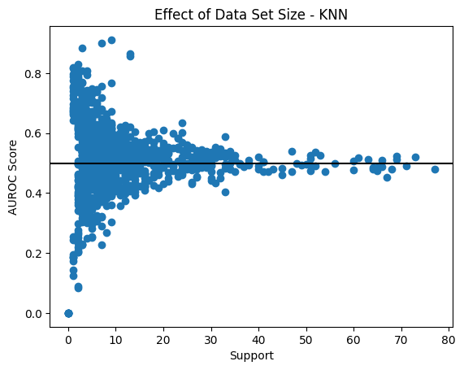
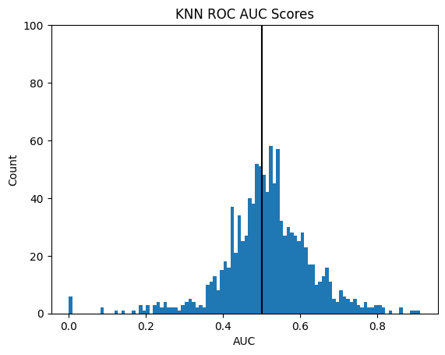
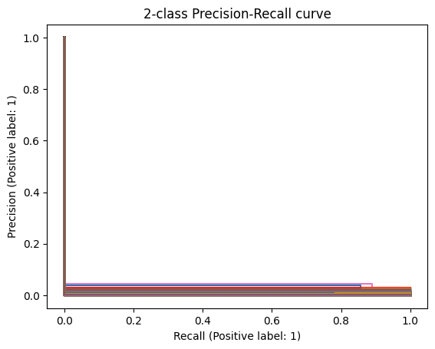
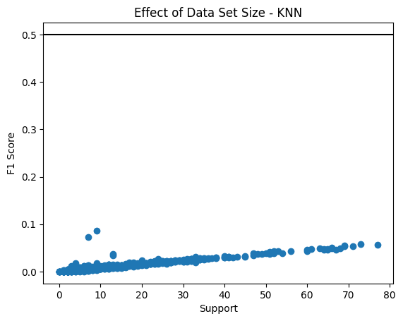
KNN Results
Mean AUROC 51.52%
Mean Weighted F1 - 31.1%

Slide 9
KNN Analysis
Best predicted GO terms ranked by ascending binary F1 Score
GO:0001819 - positive regulation of cytokine production
GO:0006811 - ion transport
GO:0006952 - defense response
GO:0045184 - establishment of protein localization
GO:0006511 - ubiquitin-dependent protein catabolic process
The Binary F1 score vs support graph shows that the KNN classifier also displays a trend of increasing score with higher support

